Slide 1
DATA MINING AND ANALYSIS (COURSE PROJECT)
PUMP IT UP : DATA MINING THE WATER TABLE
Team Members:
Vinayak Dharmatti -01FE17BCS242
Veeresh Pattar - 01FE18BCS431
Abhishek H - 01FE16BCS005
Anusha H - 01FE16BCS036
Notes:
1

Slide 2
INTRO TO CHALLENGE
The data set is from the Tanzanian Ministry of Water which is hosted by the website Drivendata
Increasing population growth and urbanization pose serious pressure on the quantity and quality of available water.
The sustainability of the present and future human life and environment depends mainly on proper water resources management.
In Tanzania major fresh water sources are not well distributed, some areas lack both surface and ground water source
By predicting the functionalities of the water pump, decreases the overall cost for the Tanzanian Ministry of Water.

Slide 3

PROBLEM STATEMENT
To predict the operating condition of a water point for each record in the given dataset.
Functional
Non functional
Functional needs to repair

Slide 4
OBJECTIVES
To obtain the pre-processed data with the best suited methodology
To perform a feature engineering to develop important attributes
To select a best suitable model for the dataset
To validate the final model on a validation data

Slide 5
UNDERSTANDING OF THE DATA
The data set is from Taarifa and the Tanzanian Ministry Of Water
25Mb of data
Training Dataset
59401 tuples
41 columns
Test Dataset
14851 tuples
40 columns
Training Set Label – status_group

Slide 6
Understanding Of Data
The file consists of 39 attributes which are mentioned below :
Amount_tsh : Total static head (amount water available to water point)
Date_recorded : The date row was entered
Funder : Who funded the well
Gps_height : Altitude of the well
Installer : Organization that installed the well
Longitude : GPS coordinate
Latitude : GPS coordinate
Wpt_name : Name of the water point if there is one
Basin : Geographic water basin
Subvillage : Geographic Location
Notes:
6

Slide 7
Contd..
11. Region : Geographic Location
12. Region_code : Geographic Location (coded)
13. District-code : Geographic Location (coded)
14. Lga : Geographic Location
15. Ward : Geographic Location
16. Population : Population around the well
17. Public_meeting : True/False
18. Recorded_by : Group entering this row of data
19. Scheme_management : Who operates the water point
20. Scheme_name : Who operates the water point
21. Construction_year : Year the water point was constructed

Slide 8
Contd..
22. Extraction_type : The kind of extraction the water point uses
23. Extraction _type_group : The kind of extraction the water point uses
24. Extraction _type_class : The kind of extraction the water point uses
25. Management : How the waterpoint is managed
26. Management_group : How the waterpoint is managed
27. Payment : The cost of water
28. Payment_type : The cost of water
29. Water_quality : The quality of water
30. Quality_group : The quality of water
31. Quantity_group : The quantity of water

Slide 9
Contd..
32. Quantity : The quantity of water
33. Source_type : The source of the water
34. Source_class : The source of the water
35. Waterpoint_type : The kind of waterpoint
36. Waterpoint_type_group : The kind of waterpoint
37. Source : The source of the water
38. Permit : If the water point is permitted

Slide 10
Pre-Processing Techniques
Removing redundant attributes
Removing the attributes that have one category
Combining of the attributes
Removing rows containing missing or 0 data as required
Analyse the few attributes with respect to class labels

Slide 11
Approach/Method
Our first approach was to find those features which would be important in predicting the result.
That is:- 1) Location
2) Population
3) Point of water
The mentioned features has missing values ,so they are filled with NaN values using mean and median

Slide 12
Data Visualization

Slide 13
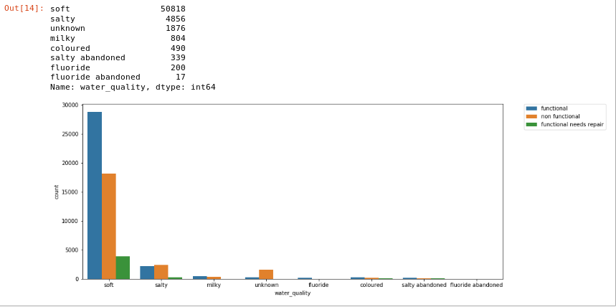
Water Quality vs Status Group
X axis: Water Quality
Y axis: Status Group

Slide 14
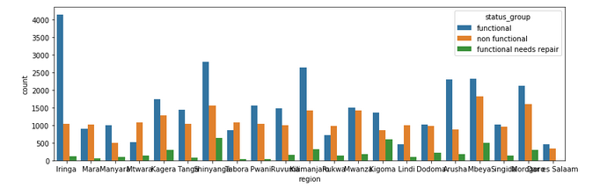
Region vs Status Group
X-axis: Region
Y-axis: Status Group

Slide 15
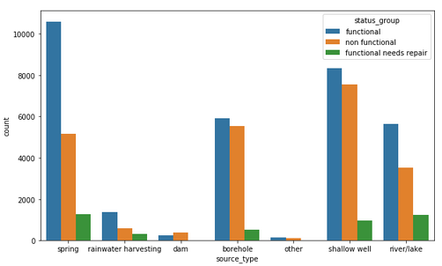
Source type vs Status group
X-axis: Source Type
Y-axis: Status Group

Slide 16
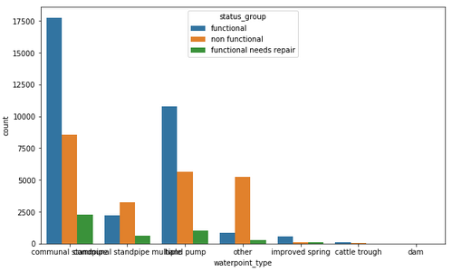
Water point type vs Status group
X-axis: Water Point
Y-axis: Status Group

Slide 17
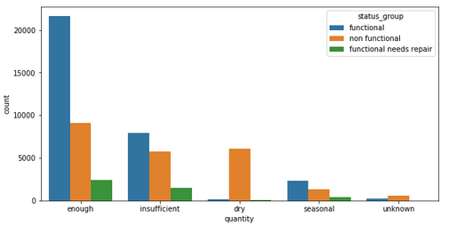
Quantity vs Status group
X-axis: Quantity
Y-axis: Status Group

Slide 18
DATA PREPROCESSING
Filling the missing values with ‘unknown’
public_meeting
permit.
Columns dropped
subvillage
scheme_name
Recorded by
num_private
Id
wpt_name
Region
ward

Slide 19
DATA PREPROCESSING
Duplicate attributes which are dropped
Dropped attribute | Similar attribute
waterpoint_type | waterpoint_type_group
Source | Source_type
quantity | Quantity_group
quality_group | Water_quality
payment | Payment_type
management | Management_type
extraction_type | extraction_type_class
extraction_type_group | extraction_type_class

Slide 20
MODEL BUILDING
ACCURACY:71.01
LINEAR SVC:
5-fold validation result:
In the above 5-fold validation result the accuracy is fluctuating from one fold to another, hence we can infer that the model is not good.
K | 1 | 2 | 3 | 4 | 5
Accuracy(%) | 65.5 | 69.6 | 43.8 | 66.9 | 47.8

Slide 21
MODEL BUILDING
ACCURACY:80.1
XGB CLASSIFIER:
5-fold validation result:
In the above table accuracy for all the fold is nearly constant.
K | 1 | 2 | 3 | 4 | 5
Acc (%) | 74.7 | 74.2 | 74.2 | 74.7 | 74.6

Slide 22
MODEL BUILDING
ACCURACY:81.46
RANDOM FOREST CLASSIFIER
5-fold validation result is almost constant for all the folds.
K | 1 | 2 | 3 | 4 | 5
Acc (%) | 79.9 | 80.4 | 80.2 | 80.5 | 80.6

Slide 23
PERFOMANCE EVALUATION
For train data
For test data
Random Forest has high accuracy for both test and train data
MODEL | ACCURACY(%)
XGB Classifier | 79.7
Random Forest Classifier | 81.46
MODEL | ACCURACY(%)
XGB Classifier | 75.8
Random Forest Classifier | 82.05

Slide 24
CONCLUSION
We addressed the following problem “Pump it up:Data mining the water table” proposed by data driven website.
Removing of duplicate attributes, replacing the low frequency values, replacing mean values are the main pre-processing techniques.
Random Forest was the model that we selected as it has high accuracy.

Slide 25
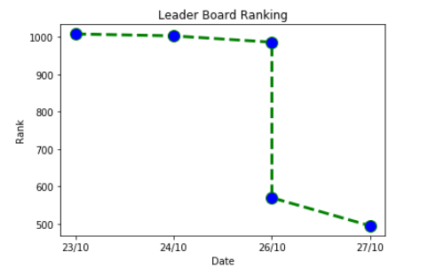
LEADER BOARD TREND
Currently in rank 495 among 7963 participants

Slide 26
THANK YOU

